Slide 1
The Evidence for Contraceptive Options and HIV Outcomes (ECHO) Trial:
Primary Results Summary
Jared Baeten MD PhD for the ECHO Trial Consortium
IAS 2019
Satellite: WHO Response to the Evidence for Contraceptive Options and HIV Outcomes (ECHO) Study
Mexico City, 23 July 2019

Slide 2

















ECHO Trial Consortium

Slide 3
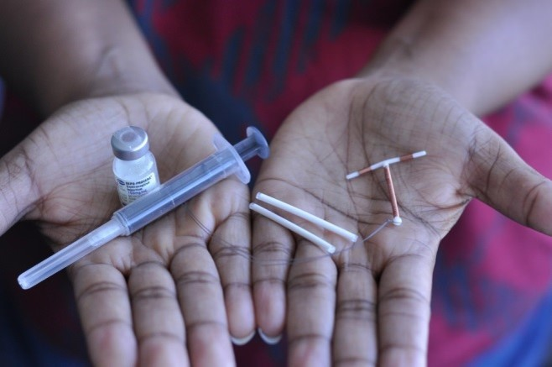

Why ECHO?

Slide 4
Context
Women represent over half of the 37 million persons currently living with HIV; nearly 600,000 new HIV infections occur yearly among adolescent girls and women in Africa.
Modern contraceptive methods are used by >700 million women worldwide, including >58 million African women.
Use of these methods substantially improves the health of women and children by averting unintended pregnancy and sequelae and contributes to women’s empowerment and to economic and social development.

Slide 5
Prior evidence
30 years of epidemiologic and laboratory studies have tried to determine whether there is truly increased risk of HIV acquisition associated with use of hormonal contraception.
Some studies showed that progestin-only injectables, particularly the intramuscular injectable depot medroxyprogesterone acetate (DMPA-IM), were linked to increased HIV risk, but other studies did not show this result.
  Some studies showed a doubling of HIV risk; in meta-analyses, the magnitude was approximately 40-50% (i.e., hazard ratios of 1.4-1.5)
Source: Polis et al., AIDS 2016

Slide 6

Women’s right to know
Women need to know whether certain contraceptives increase their chances of getting HIV. This information will help them make informed choices about which contraceptive they want to use and which HIV prevention methods they need.
A randomised trial provides the highest quality evidence to enable women to make fully informed choices, inform clear counselling messages for clinicians, and offer guidance for policymakers and programs.

Slide 7
What was ECHO?

Slide 8
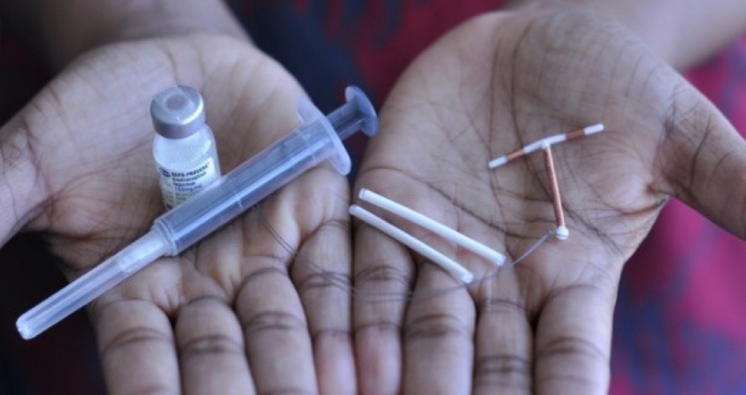
ECHO
ECHO was a multicentre, open-label, randomised clinical trial comparing HIV incidence and contraceptive benefits in women living in areas of high HIV incidence and using one of three highly-effective, licensed contraceptive methods:
  intramuscularly-delivered depot medroxyprogesterone acetate (DMPA-IM)
  a copper intrauterine device (IUD)
  and a levonorgestrel (LNG) implant
The primary objective was to compare HIV incidence among women randomised to DMPA-IM, a copper IUD, or an LNG implant.
Secondary objectives included comparison by randomised method of rates of pregnancy, contraceptive method continuation, and serious adverse events and adverse events leading to method discontinuation.
The trial began in December 2015 and concluded in October 2018.

Slide 9
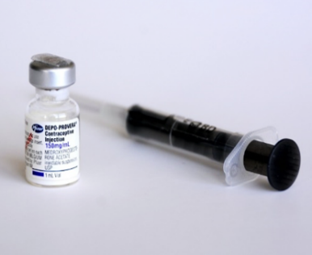
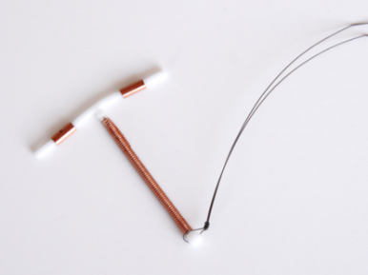
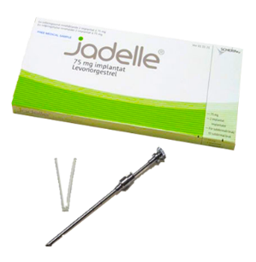
Contraceptive methods rationale
DMPA-IM was included in the trial because it is the contraceptive that observational data suggested could increase HIV susceptibility and is commonly used in many African settings that have high HIV prevalence.
We included the copper IUD to have a highly-effective non-hormonal comparator.
The LNG implant was included to represent another progestin-based contraceptive and because use of long-acting reversible methods like implants is rapidly increasing in Africa. LNG is also a part of many oral contraceptive pills and multipurpose prevention technologies in development.
DMPA-IM
Copper IUD
LNG implant

Slide 10
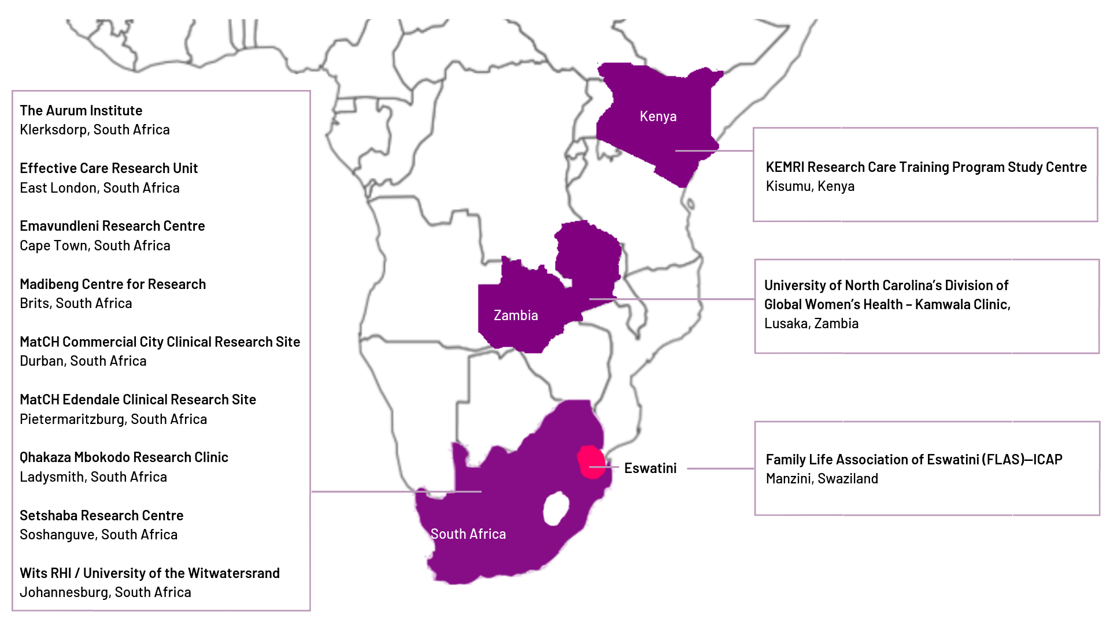
Trial sites
The trial was undertaken in 12 sites in 4 countries: Eswatini (1), Kenya (1), South Africa (9), and Zambia (1)

Slide 11
Population and follow-up
Eligibility criteria: desired effective contraception, HIV seronegative, aged 16-35 years, agreed to use the assigned method for 18 months, able to provide written, informed consent.
  Importantly, women were recruited for this trial based on residing in geographies that had high risk of HIV but not individual characteristics of HIV risk, such as transactional sex, history of STIs, or self-reported high-risk behaviours.
Study follow-up occurred at one month to address contraceptive side effects, then quarterly for up to 18 months, including HIV testing, contraceptive counselling, and safety monitoring.
  Women were counselled that they could at any time choose to discontinue their randomised method, choosing another trial method, a different contraceptive method, or no method.
  A comprehensive, individualized HIV prevention package was provided at all visits.

Slide 12
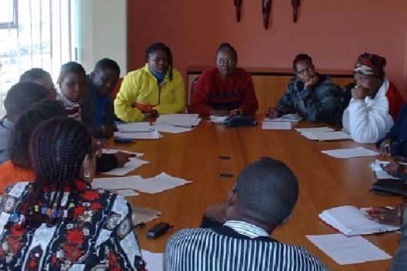
ECHO oversight
Ethics reviews for each trial site
Periodic reviews by qualified independent clinical monitors
A safety oversight committee, available 24/7 for clinical advice
Global Community Advisory Group & Community Advisory Boards at each site, with Good Participatory Practice plans
An independent Data and Safety Monitoring Board, which met twice yearly

Slide 13
Statistical design
The trial was designed with 80% power to detect a 50% increase in the hazard of HIV for each contraceptive method compared to each of the others
DMPA-IM vs copper IUD | DMPA-IM vs LNG implant | copper IUD vs LNG implant
  We chose a 50% increase in HIV risk based on formative work with stakeholders to determine a meaningful difference that would inform policy change.
Assumptions:
  underlying HIV incidence of 3.5 per 100 woman-years
  a two-sided type I error rate of 0.04 for each comparison
  10% loss to follow-up & 10% dilution of treatment effect due to method discontinuation

Slide 14
ECHO performance metrics
To do the ECHO trial well, the team, funders, and DSMB agreed prior to initiation that a key operational metrics would be reviewed continually during the study and if not met would trigger careful reevaluation of whether to stop the trial:
ECHO Performance Standard | Target (*=overall and at each site)
#1 Accrual | Achieve target sample within ~18 months
#2 Method refusal | <5% of subjects*
#3 Retention | Per-visit completion of ≥90% and ≤10% of expected person-years lost*
#4 Method discontinuation | ≤10% of all person-time off assigned method*
#5 HIV incidence | sufficient to meet the study objectives (≥3.5%/year)
#6 Ineligible enrollments | <1-2% of total*
#7 HIV endpoint adjudication | up-to-date for each DSMB review*
#8 Data quality | current for each DSMB, QC ≤5/100 CRFs, fax time ≤7d*

Slide 15
What did ECHO find?

Slide 16
Enrolment and randomised assignments
7829 women ages 16-35 desiring contraception and willing to be randomised
Randomise
(1:1:1 ratio)
DMPA‒IM
(2609 women)
Copper IUD
(2607 women)
LNG implant
(2613 women)
Eswatini 502 | Kenya 901 | South Africa 5768 | Zambia 658

Slide 17





Participant characteristics
Average age 23 (range 16-35), 63% <25 years of age
Most (81%) were not married & most (81%) had previously been pregnant at least once
Half did not use a condom with their last sex act, but only 7% reported >1 partner in the prior 3 months
STIs were common: 18% had C. trachomatis, 5% N. gonorrhoeae, and 38% HSV-2 (Deese LBPEB16)
PrEP was incorporated towards the end of the trial – 622 women used PrEP during follow-up (Beesham LBPEC25)

Slide 18
Follow-up
93.1%
Retention was 94% at the final study visit
99+% accepted their randomised method at enrolment.
Participants used their methods for 92% of the time they were in the study
DMPA-IM
89.0%
Copper IUD
93.7%
LNG implant

Slide 19


Rate of new HIV infections
In total, 397 of the 7829 women acquired HIV during the study
The overall rate of new HIV infections was 3.81% per year (95% CI 3.45-4.21).

Slide 20
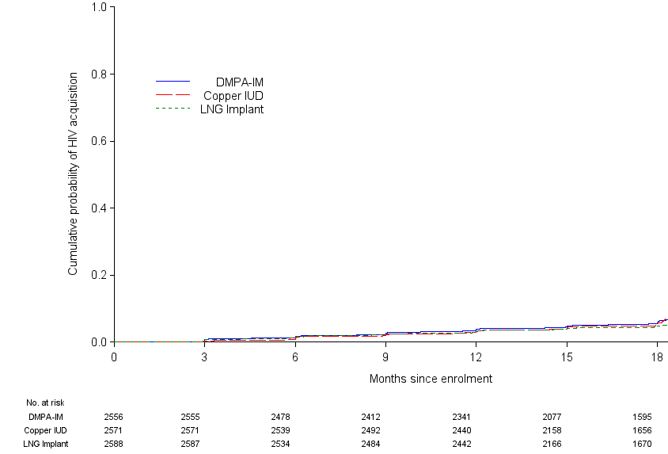
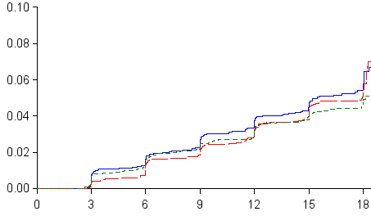
HIV incidence
Intention-to-treat analysis
 | DMPA-IM | Copper IUD | LNG Implant
# HIV infections | 143 | 138 | 116
HIV incidence, per 100 woman-years (95% CI) | 4.19 (3.54-4.94) | 3.94 (3.31-4.66) | 3.31 (2.74-3.98)

Slide 21
HIV incidence – intention-to-treat analysis
Intention-to-treat analysis
 | DMPA-IM | Copper IUD | LNG Implant
# HIV infections | 143 | 138 | 116
HIV incidence, per 100 woman-years (95% CI) | 4.19 (3.54-4.94) | 3.94 (3.31-4.66) | 3.31 (2.74-3.98)
DMPA-IM vs. Copper IUD | DMPA-IM vs. LNG Implant | Copper IUD vs. LNG Implant
HR = 1.04 | HR = 1.23 | HR = 1.18
96% CI = 0.82-1.33 | 96% CI = 0.95-1.59 | 96% CI = 0.91-1.53
p = 0.72 | p = 0.097 | p = 0.19

Slide 22
Subgroup and sensitivity analyses
Subgroup analyses – including defined by age (< & ≥25 years) and HSV-2 serostatus – results were similar to the overall findings
Sensitivity analyses were done limiting to time up until the first discontinuation of randomised method, using causal analysis methods + inverse probability weighting + adjustment for baseline and time-dependent covariates. Those results were consistent with the primary intention-to-treat analyses.
(Palanee-Phillips LBPEC23)

Slide 23
Pregnancy and Safety
Pregnancy rates were low, in all three groups, and most pregnancies (71%) occurred among women who had previously discontinued their randomised method. (Onono MOAX0103LB)
Adverse events that resulted in method discontinuation were relatively uncommon (7% of women overall) and more common among women randomised to the copper IUD or LNG implant compared to DMPA-IM
Perfect use analysis
 | DMPA-IM | Copper IUD | LNG Implant
# Pregnancies | 18 | 31 | 21
Pregnancy incidence, per 100 woman-years | 0.61 | 1.06 | 0.63
 | DMPA-IM | Copper IUD | LNG Implant
SAE | 49 (1.88%) | 92 (3.53%) | 78 (2.99%)
AE resulting in method discontinuation | 109 (4.18%) | 218 (8.36%) | 226 (8.65%)

Slide 24
How does this come together?

Slide 25
ECHO Summary
This multi-country randomised trial measured HIV incidence among African women assigned to one of three highly-effective contraceptive methods.
Acceptance of randomised method, contraceptive continuation, and retention were very high across all methods.
All three methods were effective at preventing pregnancy and were well tolerated.
HIV incidence was high for all three groups.

Slide 26
Discussion – HIV risk
We designed this trial to detect a 50% increase in HIV incidence for each of the contraceptive methods compared to each of the others. None of the comparisons showed a 50% increase in HIV incidence.

Slide 27
Discussion – HIV risk
We designed this trial to detect a 50% increase in HIV incidence for each of the contraceptive methods compared to each of the others. None of the comparisons showed a 50% increase in HIV incidence.
Under the design of this study an observed approximately 30% increase in HIV incidence would have been found to be statistically significant, and hazard ratios less than approximately 1.17 would have excluded a 50% increase in risk from the confidence interval.
For individual women at very high HIV risk, we acknowledge that even a relatively small effect might be important in contraceptive and HIV prevention decision-making.

Slide 28
Discussion – other methods
For logistical and financial feasibility, we chose to include three highly-effective contraceptive methods available in the African region, including one non-hormonal and two different progestin-only methods.
We enrolled women who desired effective contraception and did not include a placebo or no contraceptive group in this trial. The salient question is weighing the relative risks and benefits of different methods, not no method.

Slide 29
Conclusions
This well-executed randomised trial did not find a substantial difference in HIV risk among the methods evaluated, and all methods were safe and highly effective.
These results underscore the importance of continued and increased access to these three contraceptive methods, as well as expanded contraceptive choices, complemented by high-quality HIV and STI prevention services.

Slide 30

Acknowledgements
We thank the women who participated in this study for their motivation and dedication and the communities that supported this work. We are grateful to the members of the trial’s Data and Safety Monitoring Board, Global Community Advisory Group and local community advisory boards at each trial site, and overseeing ethics review committees for their expertise and guidance.
The ECHO Trial is dedicated to the memory of Dr. Ward Cates.

Slide 31






We thank the funders of the ECHO Trial who had the confidence to invest in this globally-important study
Contraceptive supplies donated by USAID and the Republic of South Africa

Slide 32
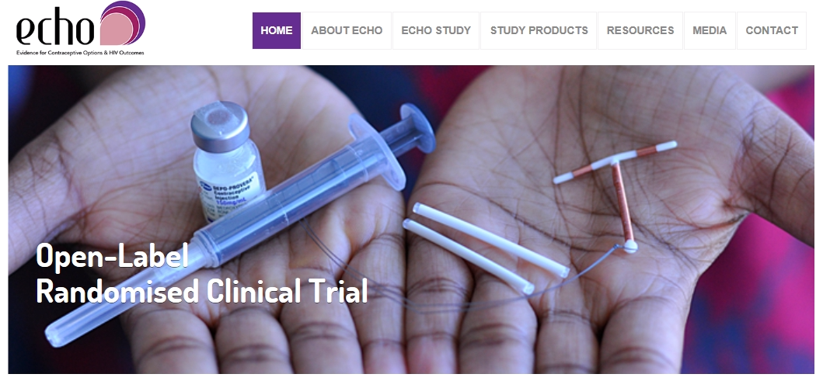
Website - www.echo-consortium.com
Results published The Lancet Online First:
http://www.thelancet.com/journals/lancet/article/PIIS0140-6736(19)31288-7/fulltext

